Slide 1
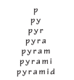

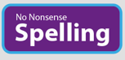
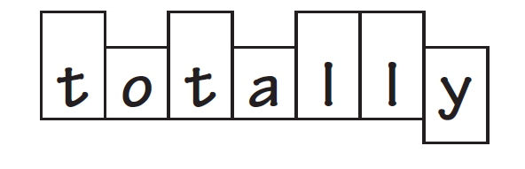

TWILIGHT:
Thursday 18th May

Slide 2
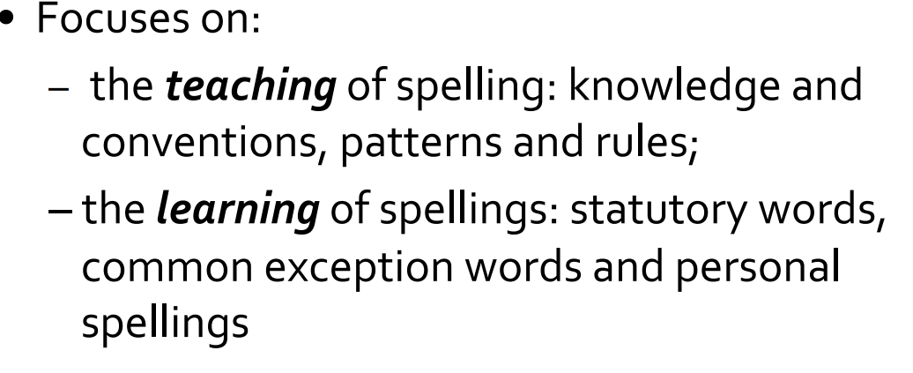
Introduction-expectations, policy, frequency
At Grove we use NNS scheme-consistency
The scheme follows a pathway so that the progression is clear-It starts from Y2 to Y6.
The scheme is structured in blocks for each half term
All children are exposed to No Nonsense Spellings but some children may have additional spelling interventions to practise spellings from Y1/2 common exception words
15-20 minute spelling sessions-daily
Some sessions are recorded in spelling journals, whilst some lessons are practical

Slide 3
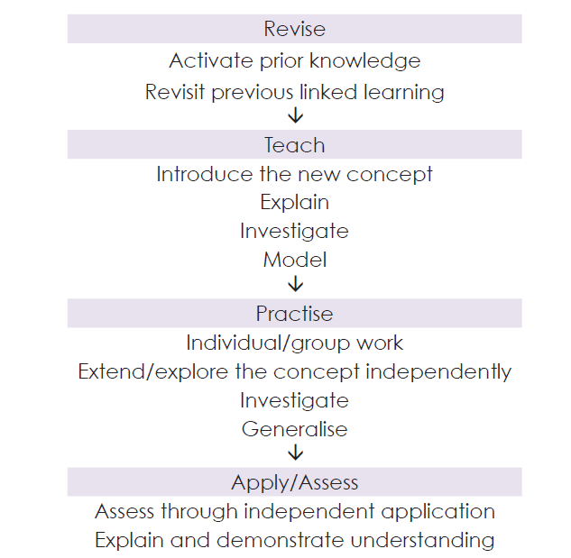
Using NNS- Lesson Types
Lessons are based on one of these types:

Slide 4
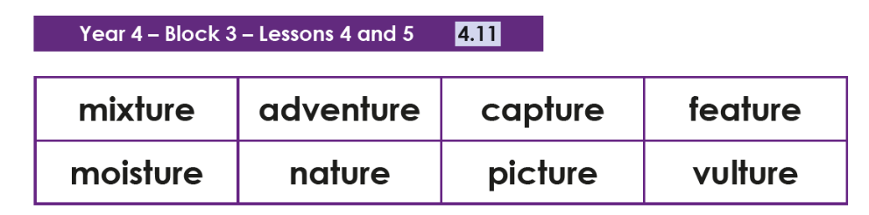
Lesson-spelling rules
Explore the sound you can here when you read the full word.

Slide 5
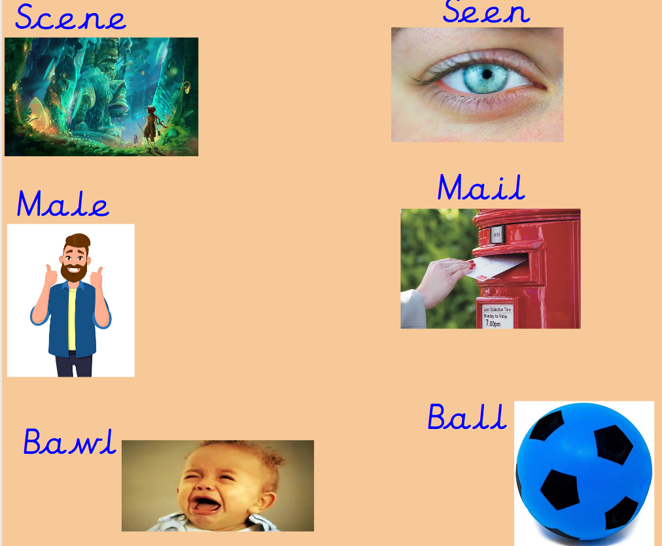
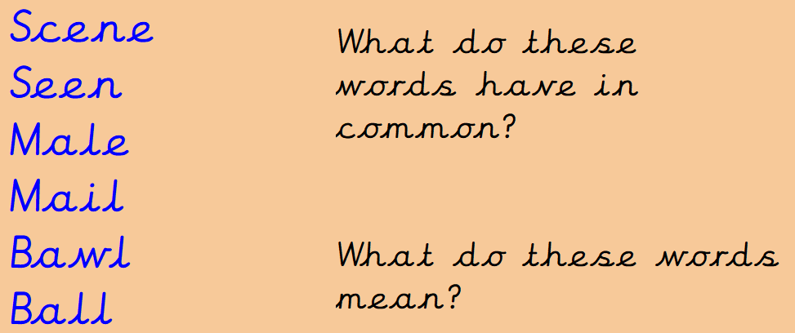
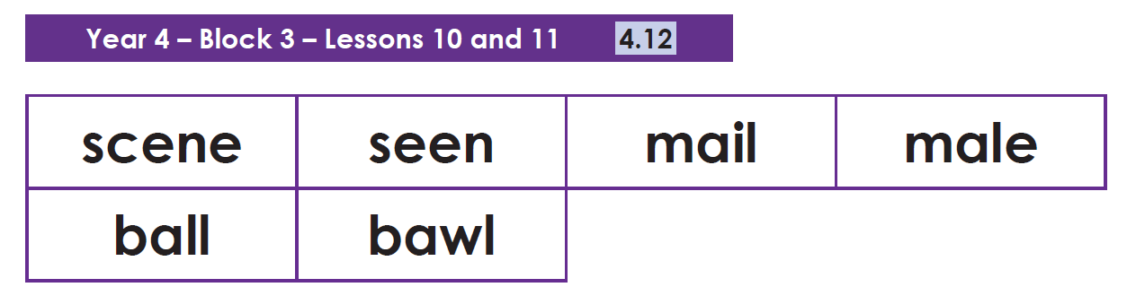
Homophones
Teach
Teach the words in context-select a word card and write a sentence.

Slide 6
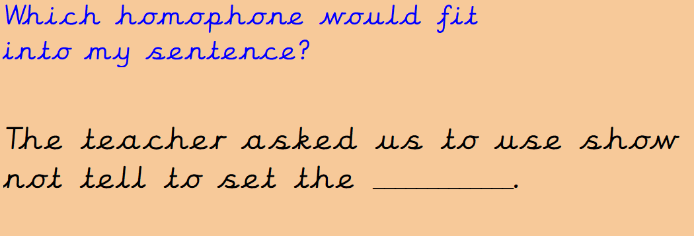
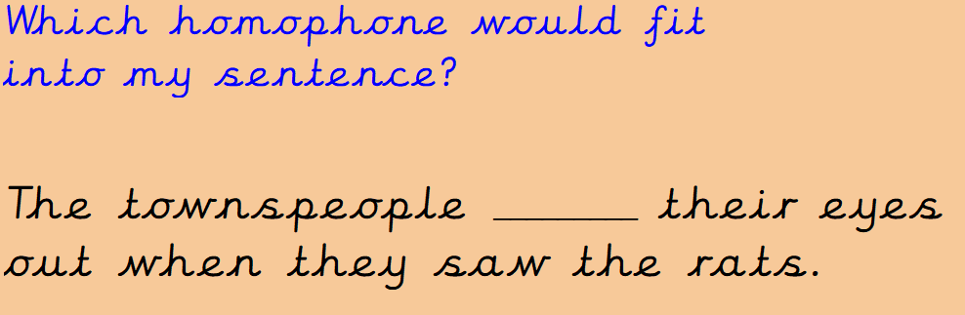
Examples…
Practise…
Show me…

Slide 7


Strategies:
Chose your strategy…

Slide 8
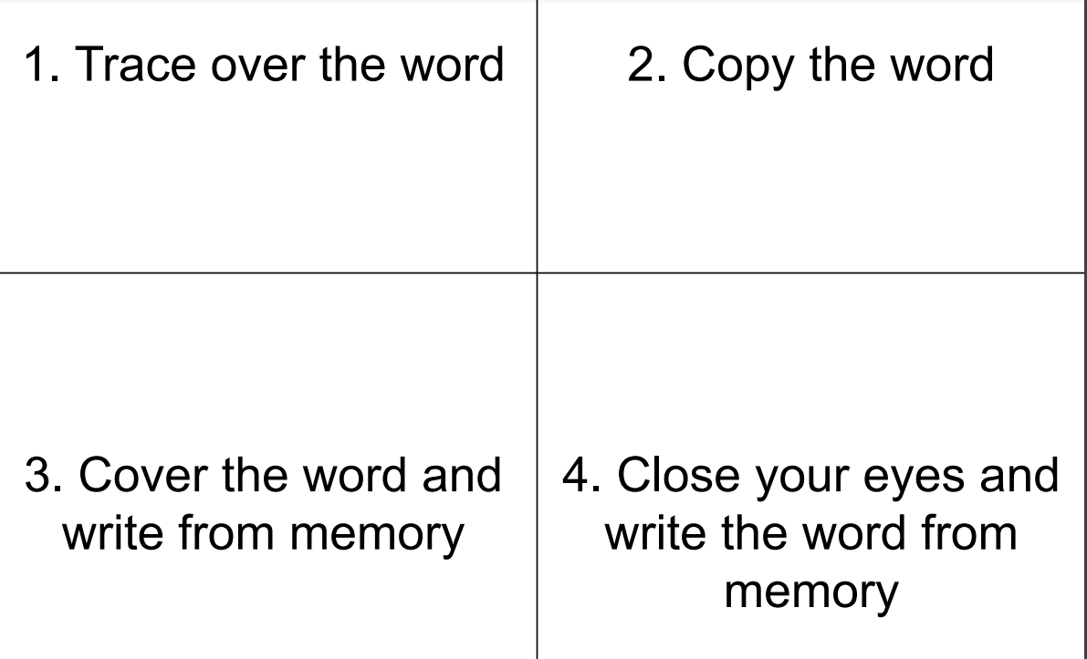

Slide 9
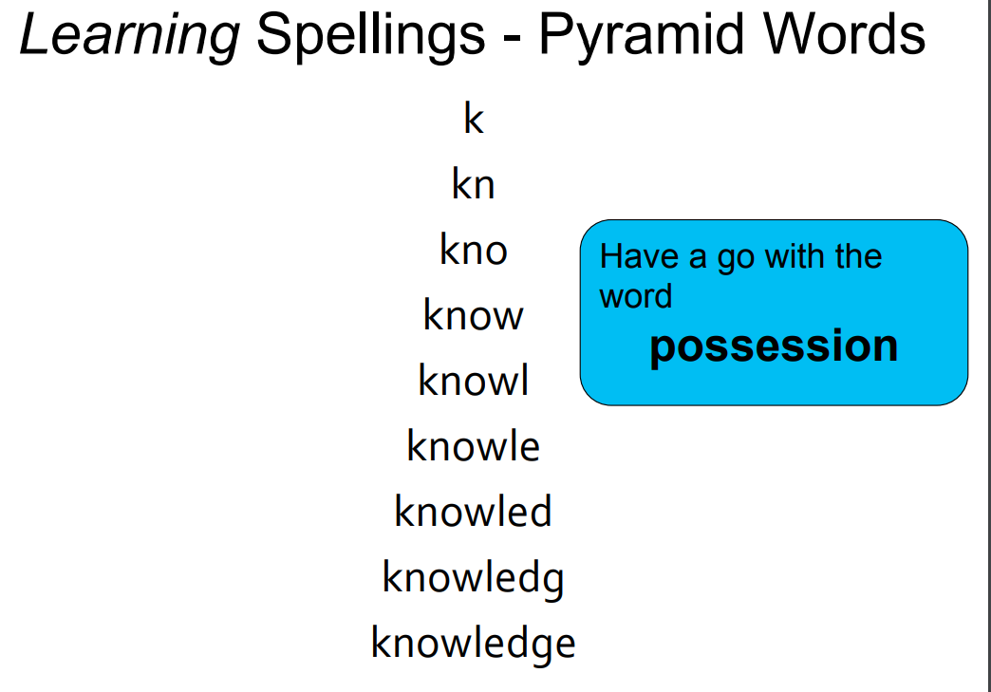

Slide 10
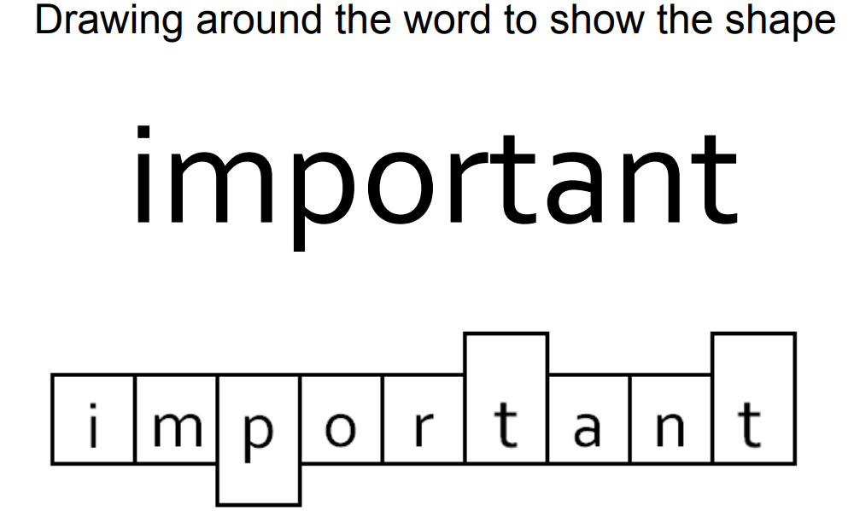

Slide 11




Slide 12
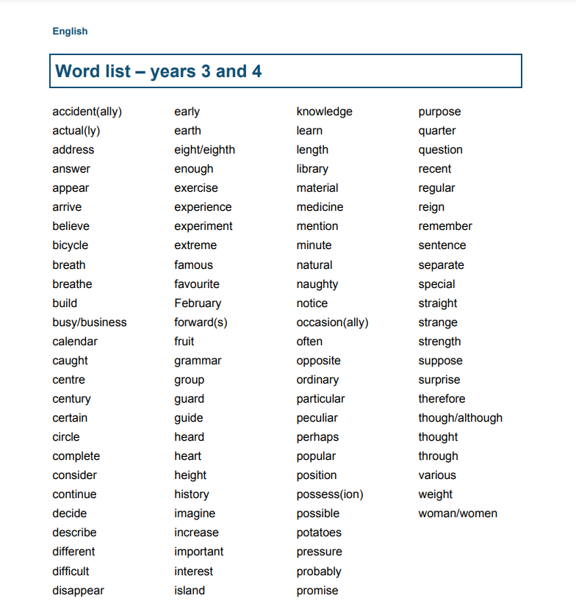

Slide 13
