Slide 1








LKS2 – Fiction Reading Spine 2023-2024
Term: | Autumn | Autumn | Spring | Spring | Summer | Summer
Year 3
Title/Author | The Three Billy Goats Gruff Jonathan Langley | The Owl who was afraid of the Dark Jill Tomlinson | George’s Marvellous medicine Roald Dahl | George’s Marvellous medicine Roald Dahl | The Fireworker-maker’s Daughter Philip Pullman | The Fireworker-maker’s Daughter Philip Pullman
Year 4
Title/Author | The Egyptian Cinderella Shirley Climo | Secrets of a Sun King Emma Carroll | Pied Piper Michael Morpurgo | Pied Piper Michael Morpurgo | Wind in the Willows Kenneth Grahame | Wind in the Willows Kenneth Grahame

Slide 2
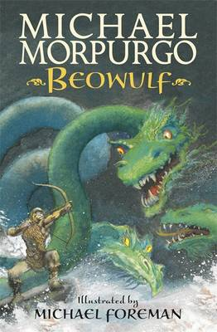





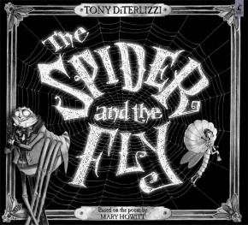
UKS2 – Fiction Reading Spine September 2023-2024
Term: | Autumn 1 | Autumn 2 | Spring 1 | Spring 2 | Summer 1 | Summer 2
Theme: | Forces, levers and pulley’s | Vikings and Anglo-Saxons | Earth and Space | Changing Britain | Properties and changes of materials | Rainforests of the Amazon
Year 5
Title/Author | Beowulf Michael Morpurgo | Beowulf Michael Morpurgo | Street Child Berlie Doherty | Street Child Berlie Doherty | The explorer Katherine Rundell | The explorer Katherine Rundell
Year 6
Title/Author | Pig Heart Boy Malorie Blackman | Pig Heart Boy Malorie Blackman | The Spider and the Fly -Mary Howitt and Tony DiTerlizzi | Trash Andy Mulligan | Trash Andy Mulligan | Wonder R J Palacio

